Slide 1
Modeling Biofuel-Induced Land Use Change using System Dynamics
ORNL, CEBES Forum
Daniel Inman, PhD
May 8th, 2013

Slide 2
Overview
Introduction to land use change and biofuels
Sustainability implications
Variability in modeling results
NREL’s LUC modeling approach
Rationale
Model structure
Results
Future direction

Slide 3
Sustainability Assessments Vary Considerably
Greenhouse gasses and net energy of corn-based ethanol ¹
 | Patzek 2004 | Pimentel et al 2005 | De Olivera et al 2005 | Shapouri et al 2004 | Farrell et al 2006 | Gasoline
GHG g CO₂ MJ⁻¹ | 122 | 117 | 99 | 61 | 77 | 94
¹ Data from Farrell et al 2006; GHG based on IPCC 100a
A survey of the literature, by NREL, indicates that there are > 60 ethanol studies
published that use LCA to some extent.
Large discrepancies exist between studies.

Slide 4
Sustainability Assessments Vary Considerably
Greenhouse gasses and net energy of corn-based ethanol ¹
 | Patzek 2004 | Pimentel et al 2005 | De Olivera et al 2005 | Shapouri et al 2004 | Farrell et al 2006 | Searchinger et al 2008 | Gasoline
GHG g CO₂ MJ⁻¹ | 122 | 117 | 99 | 61 | 77 | 138-177 | 94
¹ Data from Farrell et al 2006; GHG based on IPCC 100a
A survey of the literature, by NREL, indicates that there are > 60 ethanol studies
published that use LCA to some extent.
Large discrepancies exist between studies.

Slide 5
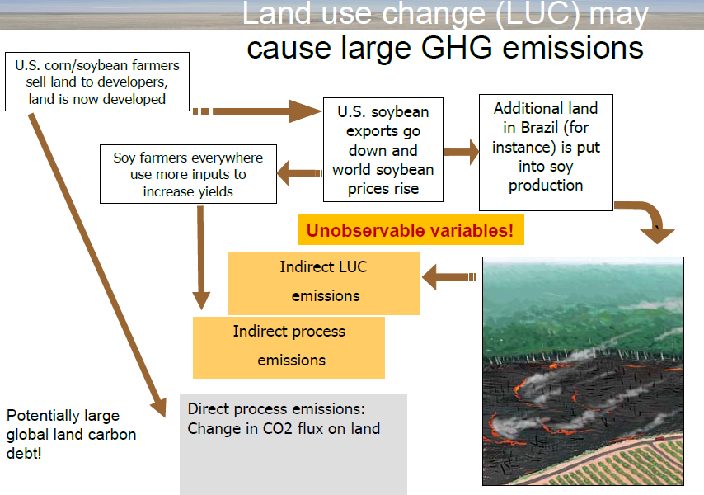
iLUC is a result of economic leakage

Slide 6
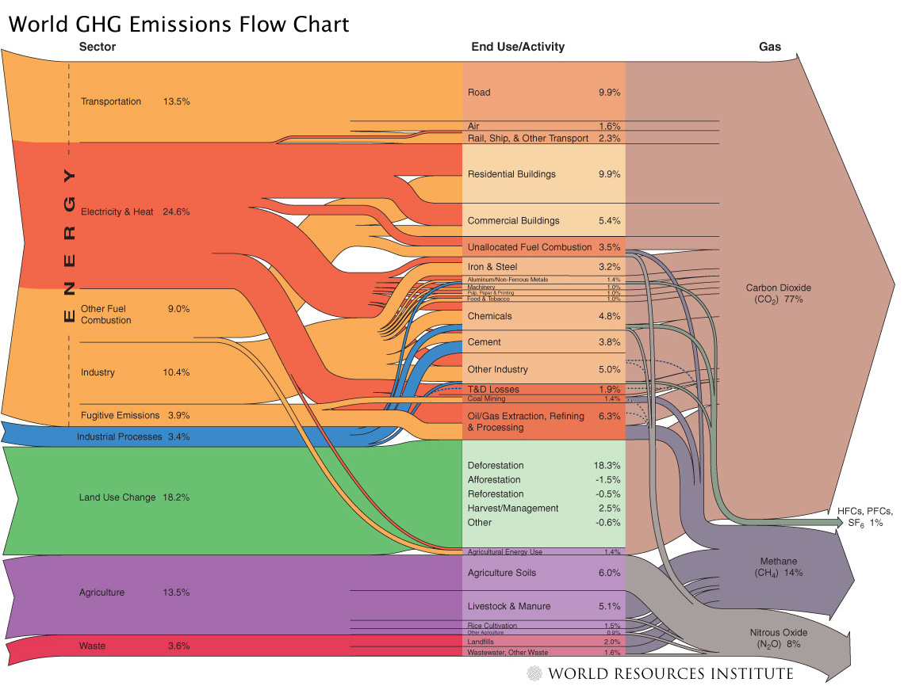
LUC ranks 2nd in terms of GHG emissions
Significant changes to
the global agricultural
system will affect LUC

Slide 7
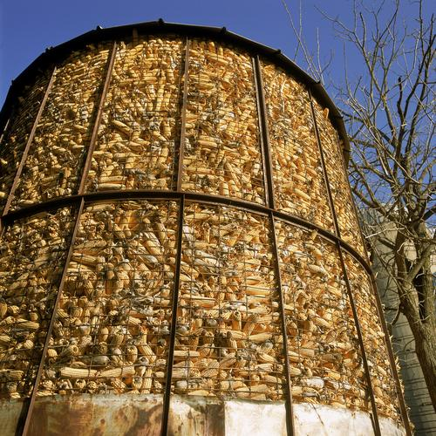
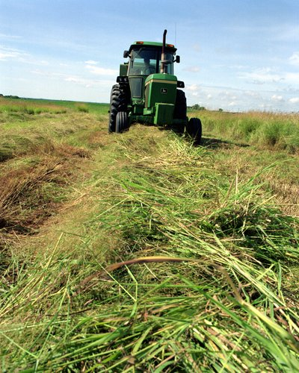

Limited Fuel Coverage of GHG_{LUC}
Current generation biofuels - Studied extensively
Cellulosic biofuels – Limited Study
Petroleum fuels – No study could be found
Limited assessment of direct land disturbance caused by conventional oil (1-4 g CO₂eq MJ⁻¹) and oil sands (19.6 g CO₂eq MJ⁻¹) was found.
(Yeh et al. 2010 and Unnasch et al. 2009)

Slide 8
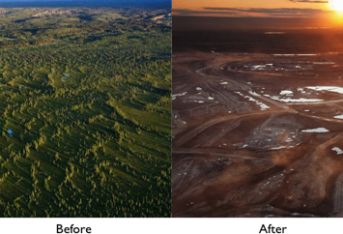
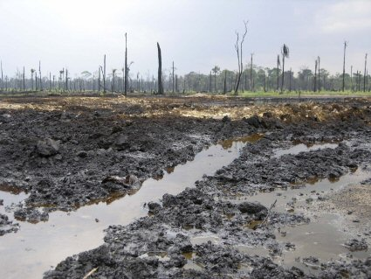
LUC is not unique to biofuels
Very few studies consider the LUC impacts of petroleum extraction.
There are studies that suggest that resource extraction is the first-order cause of LUC, biofuels are a 2nd-order impact.

Slide 9
LUC Modeling Platforms: Summary

Slide 10
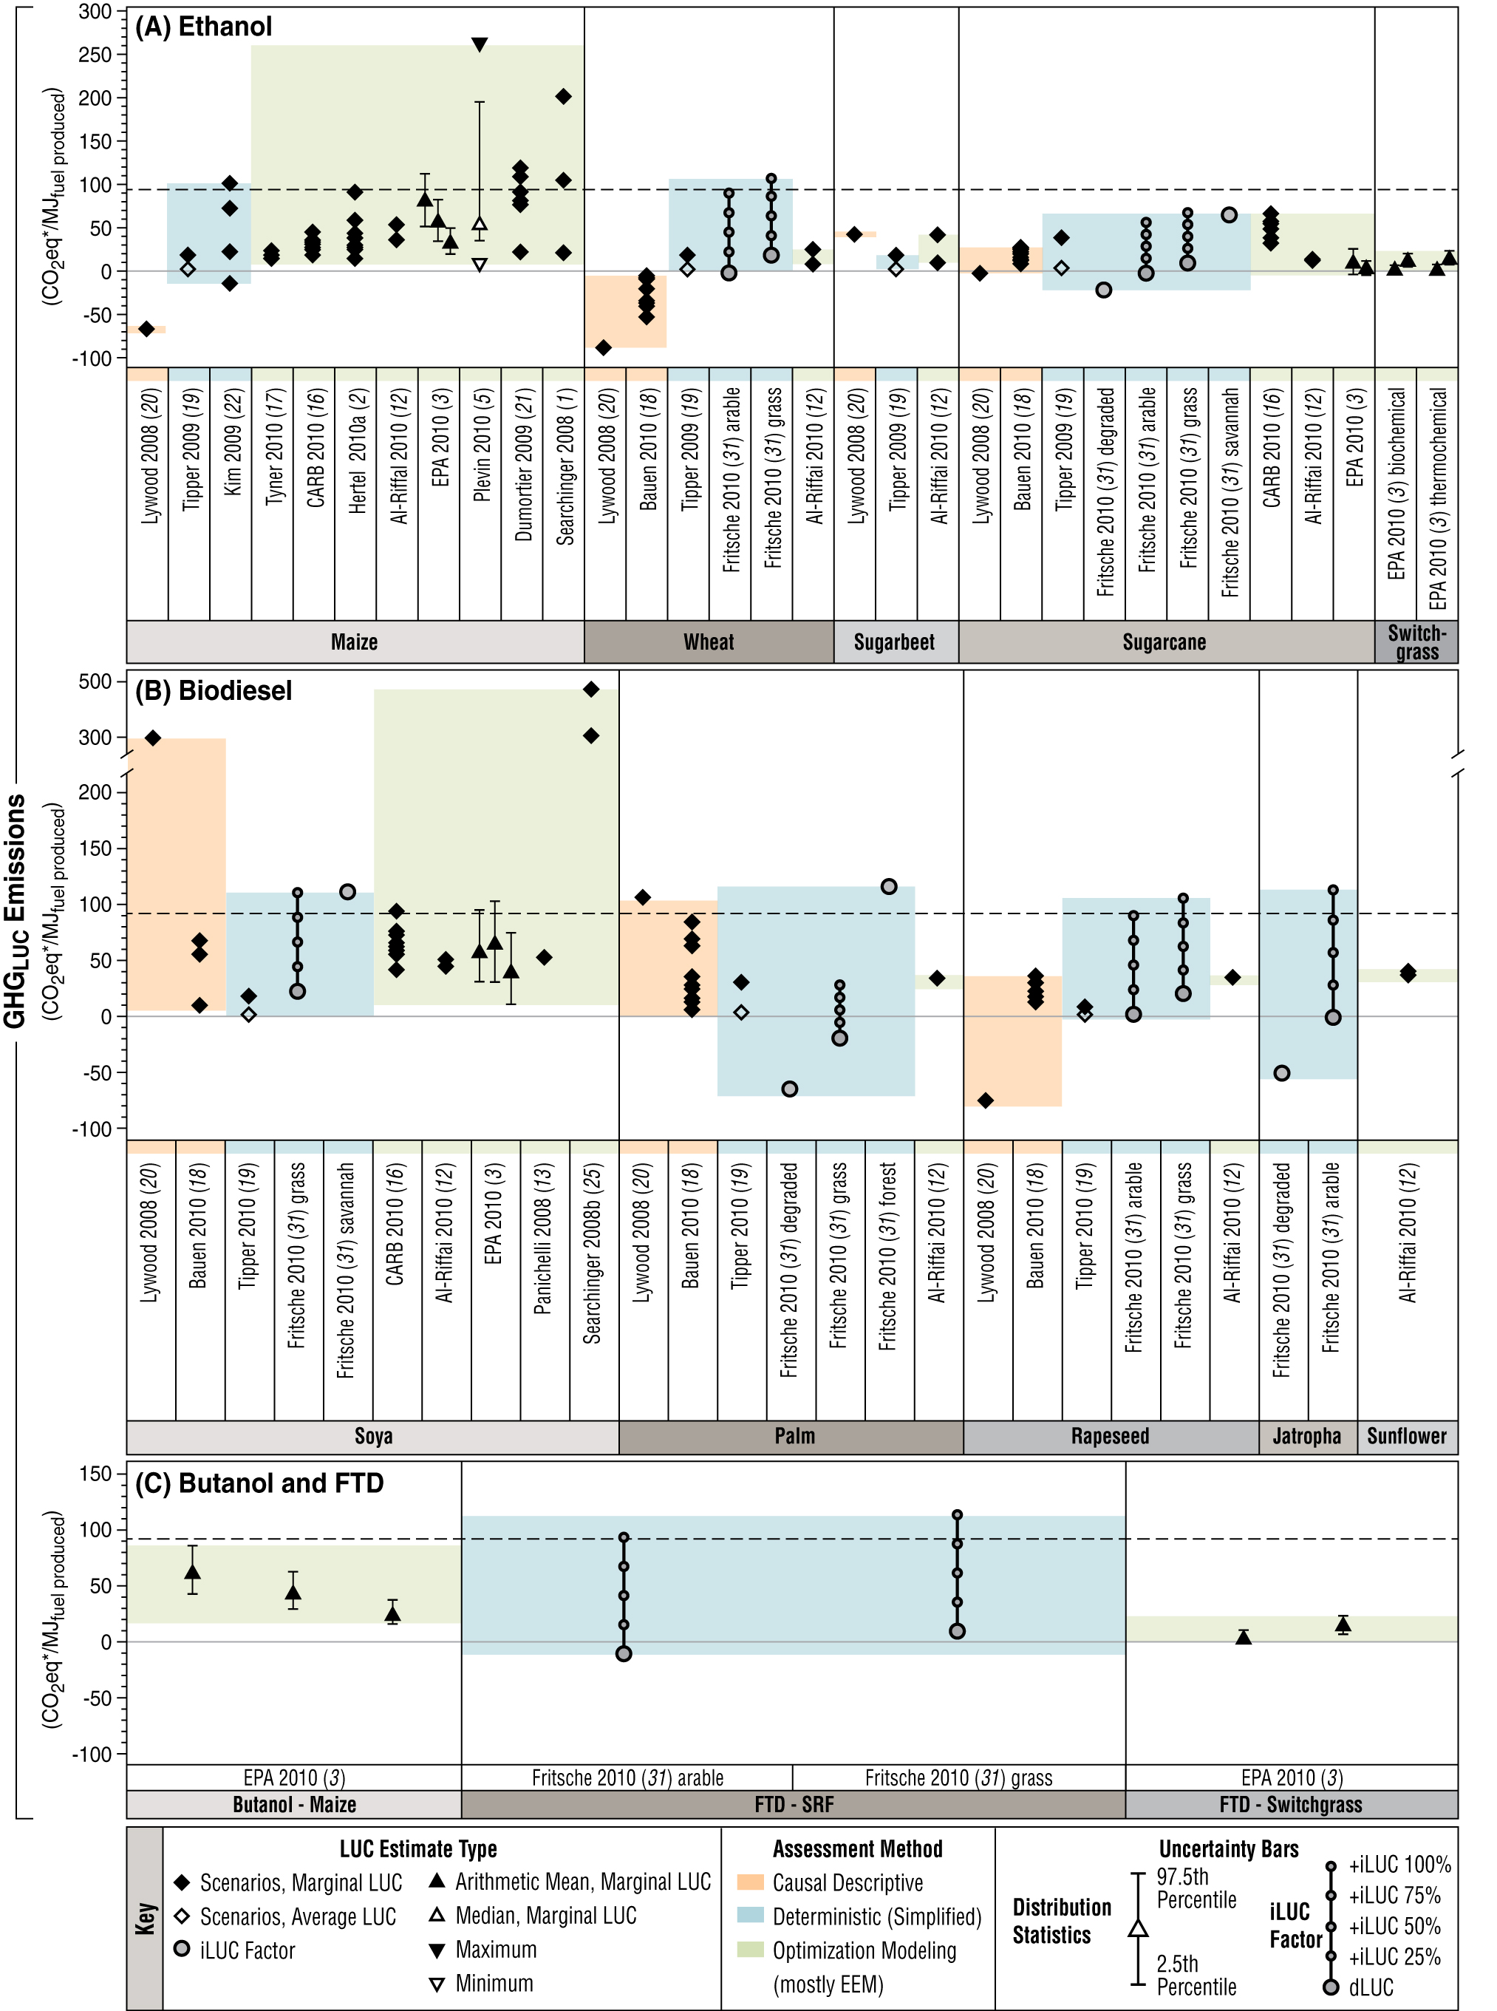
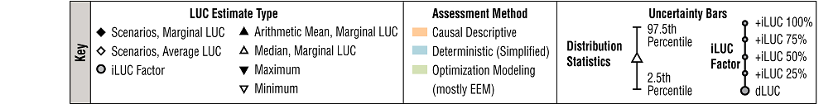
Modeled results are highly variable

Slide 11
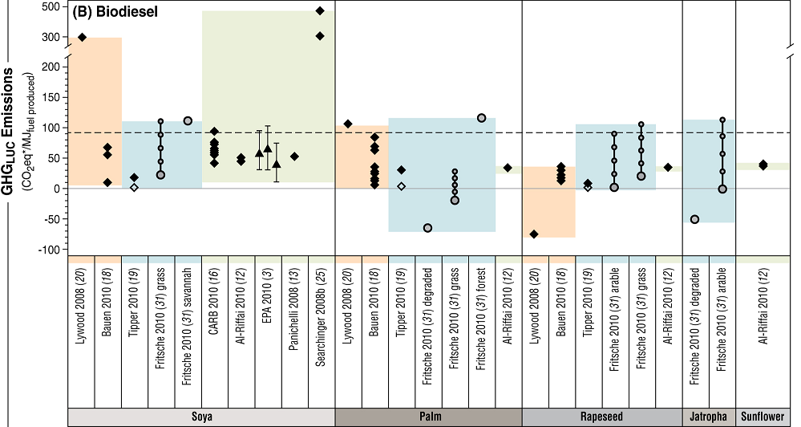
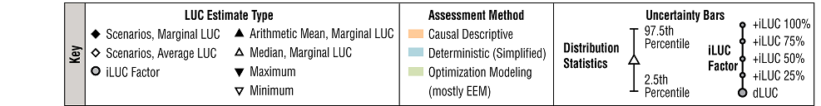
Variance in magnitude and sign across studies, pathways, and feedstocks

Slide 12
NREL’s modeling strategy & approach
System Dynamics Framework
Stocks/flows
Feedback within and across stages in supply chain
Modular, “Regional” model architecture
“Region” can reflect world, nation, geographical region, level of development, etc.
Enables rapid extension of model from 1 → 2 → n regions
Current structure includes US + 18 regions
Reliance on GDP/capita scenarios and FAO data to drive dynamics around population, yield, food demand.
Calibrate model against FAO datasets for land use and disposition.
Avoidance of explicit market mechanism

Slide 13
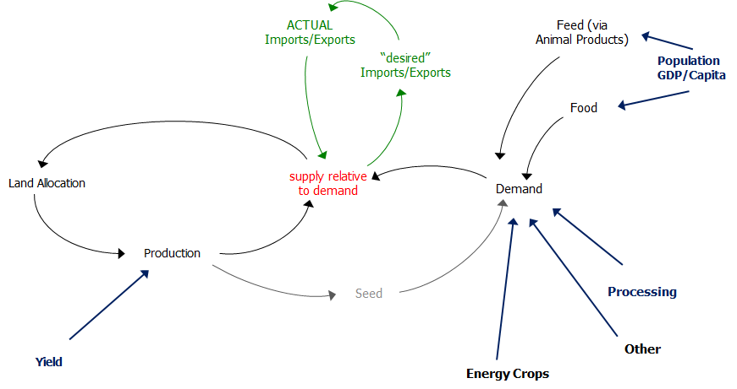
Our model captures important system interactions
Feed (via
Animal Products)
Notes:
structure and dynamics of global LUC align with key attributes of the SD toolset. One fundamental characteristic of LUC is the movement of land between usage categories (for example, abandonment of crop land) over time. In the SD model, stocks provide a mechanism for capturing the distribution of land in different classes at any point in time, while flows capture the movement of land between classes. A second characteristic of LUC relates to the mechanisms through which imbalances between production and consumption of various products from the land motivate changes in the allocation of lands among different uses. These are information feedback processes. A key feature of the NREL LUC model is its simple yet rich representation of key feedback processes that drive the allocation of land over time.

Slide 14
Land, crop, and animal classes are aggregated into larger categories
4 x 2 Land Bases
“Available” | Pasture | Cropland | Abandoned
Grassland | Forest
12 Cropland uses
Fallow
Forage
Fiber | Vegetable Fruit Nut | Other
Maize | Wheat | Rice | Grains NEC | Oil crops | Sugar
Energy Crops
Four Animal Product Categories
Cattle/Sheep/Goat | Dairy | Swine | Chicken
Induced demand from animal product to commodity crops, pasture, forage

Slide 15
Per-capita meat demand drives LUC
 | Base case system input per kg of product
Animal Class | Forage | Pasture | Maize | Wheat | Rice | NEC | Oil Crop | Sugar | Total kg
Cow Goat Sheep | 6.1 | 4.9 | 2.6 | 0.1 | 0.0 | 0.0 | 1.1 | 0.0 | 14.8
Dairy | 4.5 | 0.0 | 1.2 | 0.0 | 0.0 | 2.0 | 0.0 | 0.0 | 7.7
Pig | 0.0 | 0.0 | 1.2 | 1.4 | 0.0 | 0.3 | 0.7 | 0.0 | 3.6
Poultry | 0.0 | 0.0 | 1.4 | 0.3 | 0.0 | 0.0 | 0.6 | 0.0 | 2.4

Slide 16
Import/export structure seeks equilibrium
Basic Challenge: Provide simple mechanism for handling product movements across regional boundaries
Approach: View x-region product movements as equilibrium-seeking, but with a constraint
Supply/demand imbalance in one region drives “desire” for import/export
Total GLOBAL Imports must match total GLOBAL Export
Key insight: Global pressure (as reflected by difference in global desired import/export vs total ACTUAL import/export) translates into land use pressure.
Notes:
Avoidance of an explicit price mechanism. In market systems, price forms a feedback control mechanism that seeks to equilibrate production and consumption flows while sustaining product inventories at desired levels. Other things equal, when production is less than consumption, prices will increase. Similarly, when safety stocks of product are less than required, prices will tend to rise. The resultant price increases will stimulate production, depress consumption, and thus tend to drive the system toward equilibrium. We have chosen not to explicitly represent prices in the NREL LUC model. Instead, we have focused directly on the feedback mechanisms that equilibrate production, consumption, and inventories. When supply is out of balance with demand, the model uses the imbalance directly to motivate changes in land use, crop land allocation, and imports/exports. This allows us to capture in the model the result of the price control mechanism on the evolution of the system, without introducing the detail and dynamic complexities that come along with provision of a dynamic pricing mechanism for multiple crops and animal products in potentially multiple regions.

Slide 17
Our model is data-agnostic, but has been calibrated with FOA and WAO datasets
Most of the raw data comes from the FAO data sets.
The FAO data was processed (organized, normalized) to provide calibration data sets.
Regressions against GDP and other variables where used to develop forecasts of demands and yields.
Literature searches yielded information on land and crop inputs to livestock production, forage characteristics, and other incidental input parameters.

Slide 18
Model Results
We looked at 4 scenarios
BAU: based on WAO projections to 2050
High biofuels: 25% petroleum displacement
High food: doubling of per-capita food demand
High biofuels and food: 25% petroleum displacement and doubling per capita food demand

Slide 19
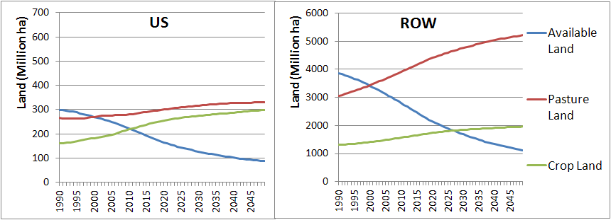
BAU results for the US and ROW
Notes:
In the BAU case, the ROW population is expected to continue growing and becoming more affluent thus eating more and more meat-especially beef…

Slide 20
BAU results for the US and ROW
Pasture land expands to supply
increased meat demand
Notes:
In the BAU case, the ROW population is expected to continue growing and becoming more affluent thus eating more and more meat-especially beef…

Slide 21
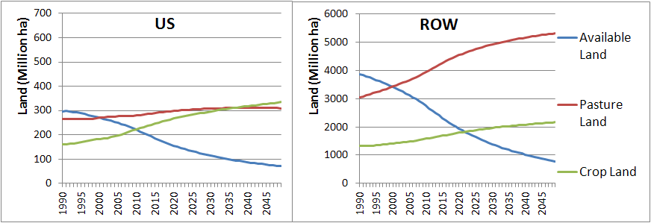
High food demand-US and ROW
Notes:
The HF scenario has land moving to cropland from pasture and then from available land (i.e., forest and grassland). Relative to the BAU scenario, to meet growing demand for food products cropland increases by about 10% globally by the end of the simulation. US cropland expansion to meet rising food requirements occurs mostly at the expense of available land but also some pastureland. In the ROW, cropland expansion occurs exclusively on available land. Pasture land in the ROW increases in the HF scenario to help supply higher meat requirements.

Slide 22
High food demand-US and ROW
ROW pasture expands
to supply meat
Cropland expands by circa 10%
Cropland pulls from pasture
Notes:
The HF scenario has land moving to cropland from pasture and then from available land (i.e., forest and grassland). Relative to the BAU scenario, to meet growing demand for food products cropland increases by about 10% globally by the end of the simulation. US cropland expansion to meet rising food requirements occurs mostly at the expense of available land but also some pastureland. In the ROW, cropland expansion occurs exclusively on available land. Pasture land in the ROW increases in the HF scenario to help supply higher meat requirements.

Slide 23
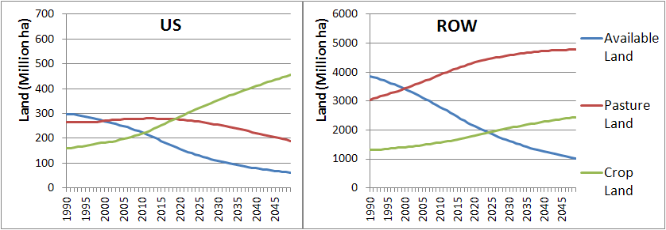
High biofuel demand: US and ROW
Notes:
In the HB scenario, cropland is expanded more significantly to meet the high demand for biofuels than in the HF scenario, but with different tradeoffs. To meet the high biofuel requirements about 700 million ha of land are required globally. Relative to the BAU scenario, US cropland area grows by about 50% and the ROW cropland grows by about 25% by the end of the simulation. US cropland expansion to meet biofuel requirements is met almost exclusively by pastureland area being pulled into cropland production with some available land pulled into pasture and cropland. The available land pulled into pasture or cropland in the HF and HB scenario are very similar. These trends continue for the ROW such that as compared to the HF scenario much less available land is actually used.

Slide 24
High biofuel demand: US and ROW
To meet aggressive biofuel and food demand
circa 700 million hectares are needed
Pastureland supplies
much of the land
Cropland expands by over 50% (US) and 25% (ROW)
Notes:
In the HB scenario, cropland is expanded more significantly to meet the high demand for biofuels than in the HF scenario, but with different tradeoffs. To meet the high biofuel requirements about 700 million ha of land are required globally. Relative to the BAU scenario, US cropland area grows by about 50% and the ROW cropland grows by about 25% by the end of the simulation. US cropland expansion to meet biofuel requirements is met almost exclusively by pastureland area being pulled into cropland production with some available land pulled into pasture and cropland. The available land pulled into pasture or cropland in the HF and HB scenario are very similar. These trends continue for the ROW such that as compared to the HF scenario much less available land is actually used.

Slide 25
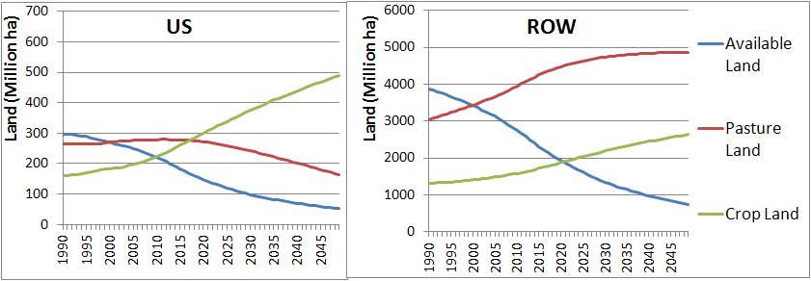
High food and biofuel demand
Notes:
Even though pasture land increased in the high food demand scenario it decreased in the HF and HFB scenario. These results highlight an underlying dynamic occurring to some extent across all scenarios of the model. In later years at various times there are meat production shortfalls, in particular for high land intensity commodities (e.g., beef), but because biofuel us of land was given priority shortfalls were highest in these scenarios. Despite higher food demands in the HFB scenario, pasture land growth is much lower than in the HF scenario because of greater supply shortfalls due priority allocation to biofuels. In practical terms such a shortfall could be avoided through various means such as de-prioritizing biofuels, switching to lower land use meat use, and other alternative scenarios we have not examined here. It should be noted that this meat shortfall does not imply a caloric shortfall. Demands for other commodities such as cereals are being met at most points in time in other scenarios. The exception is in the ROW HFB scenario between about 2010-2030 where there are the most rapid shifts in land use and commodities demanded.

Slide 26
High food and biofuel demand
Pasture land is being pulled into biofuel production
and can’t respond as well to growing meat demands
Notes:
Even though pasture land increased in the high food demand scenario it decreased in the HF and HFB scenario. These results highlight an underlying dynamic occurring to some extent across all scenarios of the model. In later years at various times there are meat production shortfalls, in particular for high land intensity commodities (e.g., beef), but because biofuel us of land was given priority shortfalls were highest in these scenarios. Despite higher food demands in the HFB scenario, pasture land growth is much lower than in the HF scenario because of greater supply shortfalls due priority allocation to biofuels. In practical terms such a shortfall could be avoided through various means such as de-prioritizing biofuels, switching to lower land use meat use, and other alternative scenarios we have not examined here. It should be noted that this meat shortfall does not imply a caloric shortfall. Demands for other commodities such as cereals are being met at most points in time in other scenarios. The exception is in the ROW HFB scenario between about 2010-2030 where there are the most rapid shifts in land use and commodities demanded.

Slide 27
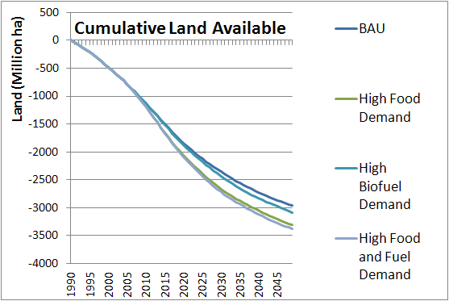
Available land trends across scenarios
High food demands cause expansion of
pasture at the cost of available lands

Slide 28
Conclusions
Overall, our results suggest that even in a future with high food and biofuel demands there is enough “available” land to meet both food and fuel needs.
Most of the land is supplied by pasture
Demand for land-intensive meat is difficult to supply under the high biofuel scenarios

